Slide 1
Self Navigation
Armando, Samantha, Mikhail, Shajidul

Slide 2
Introduction
An abstract object to move around the environment
Avoid obstacles such as streets and other objects
Learn an optimal path from point A to point B
Adapt to small changes in the environment and make decisions
Implement simulation with real vehicles
Improve self driving vehicles

Slide 3
Background
Robot : Best Time
Breadth-First Search (BFS)
Depth-First Search (DFS)
Bellman-Ford Algorithm
Dijkstra’s Algorithm
Notes:
BFS: uninformed search – starts with root node then neighboring nodes then unexplored neighboring nodes (lower level in hierarchy) : minimal calculating time
DFS: uninformed search - starts at a node then explores down the branch before backtracking to another branch; search continues until it reaches 1 of 2 conditions then searches the next condition
Dijkstra’s: graph traversal algorithm, starts at point a hen searches shortest route; starts at s node then expands; expands as vertices arr added based on length
Bellman: singe source shortest paths – similar to Dijkstra’s but considers edges

Slide 4
Background
Cars
Short Term – Neaural Networks
Feedforward & Recurrent
Long Term (Driving Event) – Markov Models
Current Events vs. Past Events
Video Games
Racing Games

Slide 5
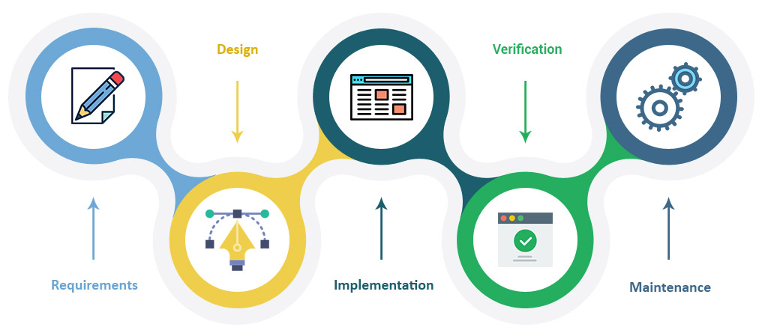
Development

Slide 6
Algorithm: Reinforcement Learning
Reinforcement learning: The algorithm gets to choose an action in response to each data point. It is a common approach in robotics, where the set of sensor readings at one point in time is a data point, and the algorithm must choose the robot’s next action. It's also a natural fit for Internet of Things applications. The learning algorithm also receives a reward signal a short time later, indicating how good the decision was.
This is the perfect algorithm for our vehicle since it will be maneuvering different obstacles with randomized paths. The car that reaches the farther distance it will get rewarded.

Slide 7
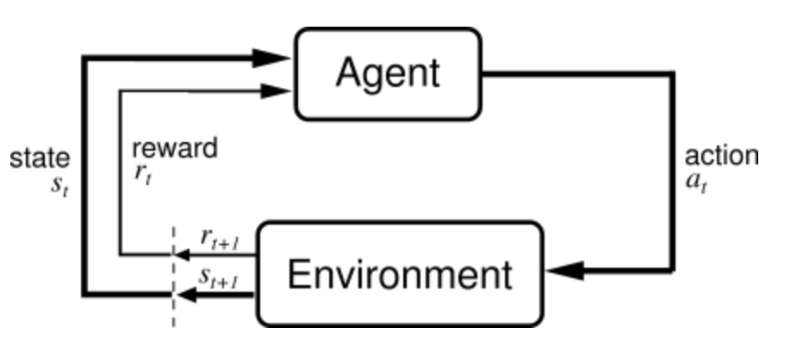
Reinforcement Learning
Agent: Vehicle
Environment: Surface with obstacles
Actions:
Move left , right, up, and down on the surface.
Detecting Obstacles.
Maneuvering Obstacles.
States:
The vehicle moving.
Detecting an obstacle.
Vehicle not moving.
Rewards:
String/number indicating it’s good or bad.

Slide 8
Data Structure: Main Objects
Car
Move (be able to move alone)
Detecting( be able to get data from the environment)
Cerebro (Save the collected data so it will travel by itself )
And more like draw(to display it self)..
Obstacle: Fix long walls
End and beginning coordinates.
Width and height, as well area so we know when to avoid obstacles.
Environment:
A canvas with a fix width and height.
Other stuff .. like color, displaying coordinates..

Slide 9
Data Collected by each object
Car
Previous movement coordinates that led to the common state
Previous “rewards” to know which is the best path.
Walls
The randomize walls locations.
The height and width.
The start and end coordinates of the walls.

Slide 10
Goals:
Multiple cars be in sync and and reach the same goal
Less Trials
Shorter Travel Time
Generate random Paths
Execute http-server

Slide 11
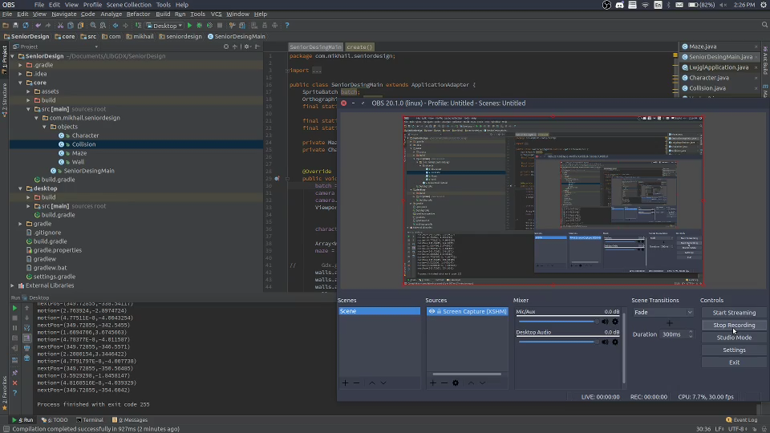
Prototype:

